Slide 1
Ez-Mode mTLS
OR
Securing a legacy Revenue Generating app

Slide 2

curl http://whoami.ru/intro.sh | sudo bash -
Sol Roberts
@BadgerOps
Sysadmin/DevOps guy
I like long walks on the beach, shitposting on twitter and yaml. Not necessarily in that order…
Currently: building engineering teams @ PlexTrac
Notes:
I first had the twitter handle “Badger32d” because at the time I was a combat engineer in the Army, and our unit callsign was “Badger”
I also identified as a surly mammal who didn’t really like people.
I’m less surly now (mostly) and like people more (mostly) but the handle has stuck, I just added Ops because, well… badger.com was taken but badgerops wasn’t.
I’ve been doing system operations / sysadmin’y things since the early 2000’s, starting in windows, quickly moving to Linux and then “the cloud”
Also yes, please, please don’t curl | bash!

Slide 3


Slide 4
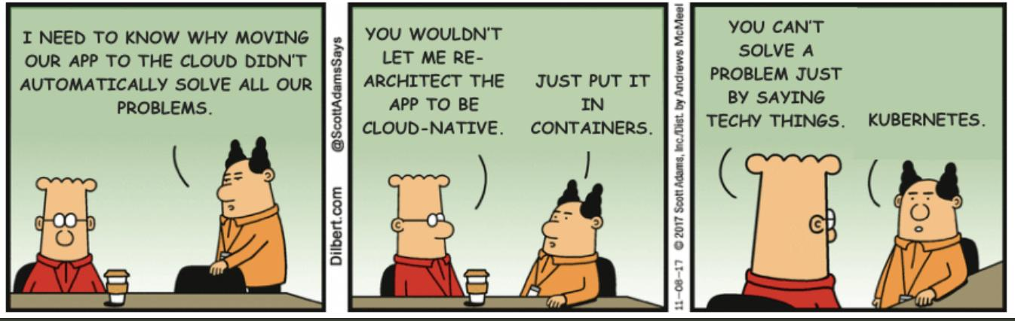
…...Just me?
Notes:
So…..
I’d like to say this is a joke, but… I’ve been through this process 3 times now. Moving an old / “Legacy” (Revenue Generating! (DRINK)) application to “the cloud”
In every single case, there was at least one piece that didn’t have TLS, and these very, shall we say, *time proven* apps don’t generally the ability to easily add TLS.

Slide 5
What is mTLS?
Extremely great overview at https://buoyant.io/mtls-guide/
mTLS is “regular TLS” with one extra stipulation: the client is also authenticated.
Why does this matter?
  Confidentiality
  Authenticity
  Integrity
  But more importantly: Authorization
Notes:
mTLS is very useful in microservice architecture
The TLS CIA triad (not that other CIA triad) gives us Confidentiality, Authenticity and Integrity
mTLS gives us authorization which is the most important aspect of this
what good is TLS if we can just throw another pod out there and join the mesh and pwn everything that way?
Use Pod Security Policies (PSP) to accomplish this: Linkerd + PSP = pods that are explicitly allowed to talk to each other, and TLS’d all the way.

Slide 6
4 letter word: Certificate Management.
Certificate management sucks
Rotating keys sucks
Validating sucks
Managing CA’s suck(s?)
Linkerd:
  Automatically rotate issuer certs on a configurable basis
  Already rotates proxy certs every 24hr
Can be configured to use upstream cert managers, such as
  Vault
  Venafi
  AWS KMS
Notes:
I don’t think I need to say anything more here
I mean, I use GPG for emails and, well, it sucks.
Linkerd has done a great job of automating all the annoying things about TLS cert management, and ties in well with several popular upstream cert management platforms

Slide 7
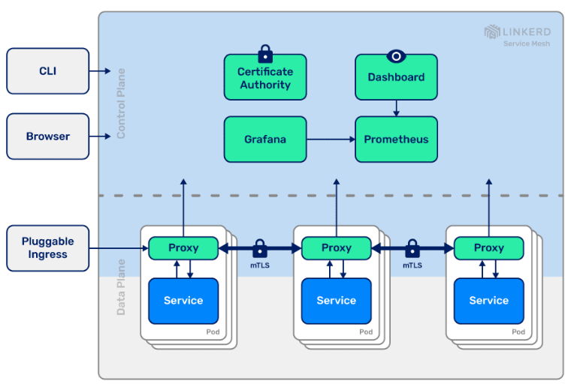
Notes:
This is a 30,000’ foot view of Linkerd, divided into 2 planes - control and data.
Control plane handles the CA, visualization dashboard (optional) and metrics collection, you can also send to a centralized prometheus server
Data plane is 1 proxy per service that you have linkerd injected into. The proxies will get their certs from the CA, and mTLS to each other, based on PSP’s like we discussed earlier

Slide 8
The stack
Kubernetes cluster (Kind: Kubernetes In Docker)
  Quickly spin up demo K8s clusters using Docker
Linkerd
  The world's best™ service mesh
Emojivoto app
  Premier emoji voting webapp
Notes:
As it turns out, none of my previous employers would allow me use their apps as an example, so we have a contrived example in the form of “emojivoto” - the premier app for voting on your favorite emoji!
This allows us to see before & after plaintext and then, well, NOT plain text

Slide 9
The Live Demo!
/me prays to demo gods before starting
Notes:
DFIU

Slide 10
The recorded demo, because live demo failed! :sad_parrot:

Slide 11
Links:
Talk notes / docs: https://github.com/BadgerOps/bsides-if-2022
Kind: https://kind.sigs.k8s.io/
Ksniff: https://github.com/eldadru/ksniff
Linkerd Pod Security Policy: https://linkerd.io/2.10/tasks/using-psp/
Buoyant mTLS docs: https://buoyant.io/mtls-guide/
Emojivoto app: https://github.com/BuoyantIO/emojivoto
@BadgerOps

